Slide 1

Notes:
Company that provides business Intelligence and data visualization software
Extremely dynamic
Stores and compresses data

Slide 2
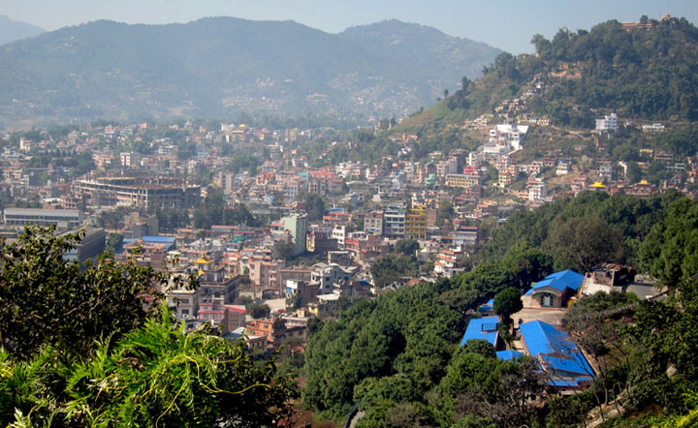

Lund, Sweden
UIKVIEW
Notes:
QUIK = Quality, Understanding, Interaction, Knowledge

Slide 3
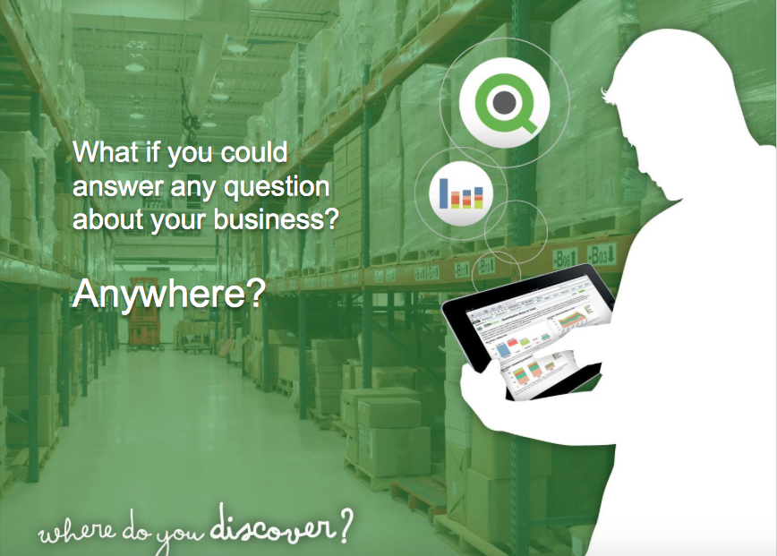
Notes:
Extremely dynamic
Fastest growing BI company

Slide 4
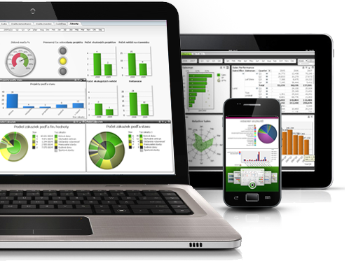
QlikView Mobile
Notes:
Engaging user interface
Same Qlikview on all devices
Live Data
Manageable and secure

Slide 5
Company Status
34,000 customers in 100 countries
More than 1,200 partners in 90 countries
Over 1,000 employees in 30 countries
65,000 QlikCommunity members

Slide 6
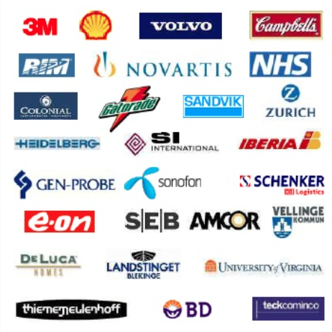
Notes:
Large companies such as Gatorade, Shell, Campbells and more
These companies all had a need for data management and presentation and QlikView fulfilled this need

Slide 7
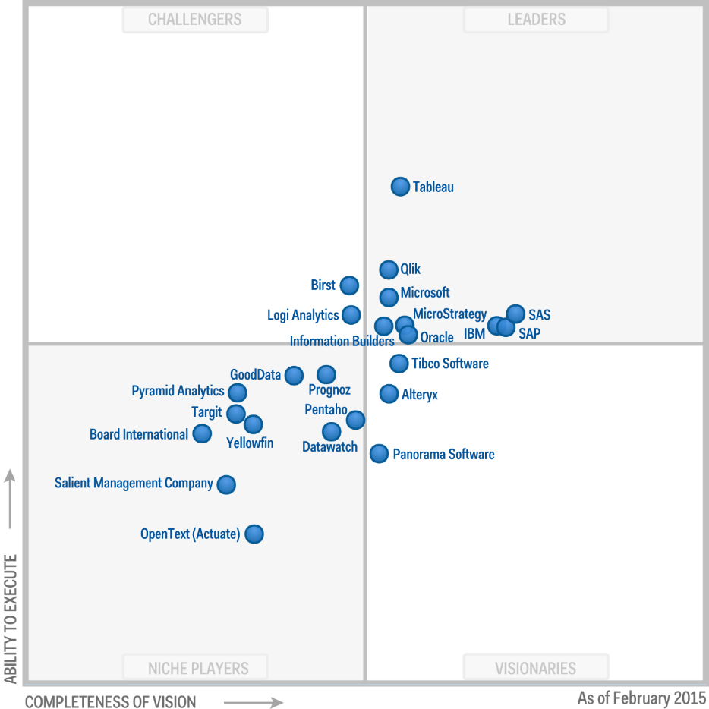
Notes:
- According to Gartner, a company in research technology, Qlik is among the top competitors for business intelligence and analytics.
As you can see on the screen, they are even above Microsoft, IBM, Oracle and others
In the leader section because of their ability to execute and completeness of vision

Slide 8
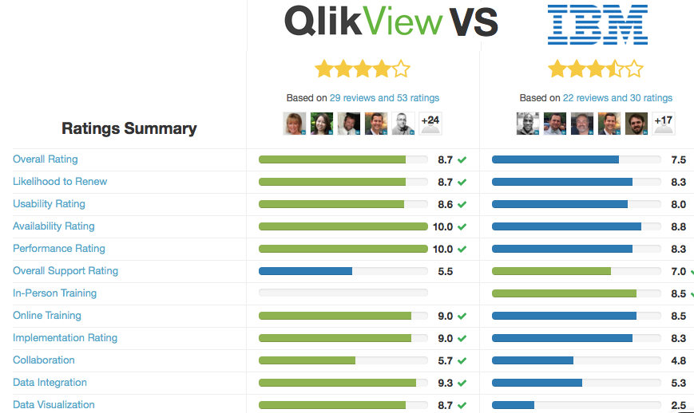
Notes:
According to trustradius.com
As you can see, QlikView has a better rating in every category other than 2

Slide 9
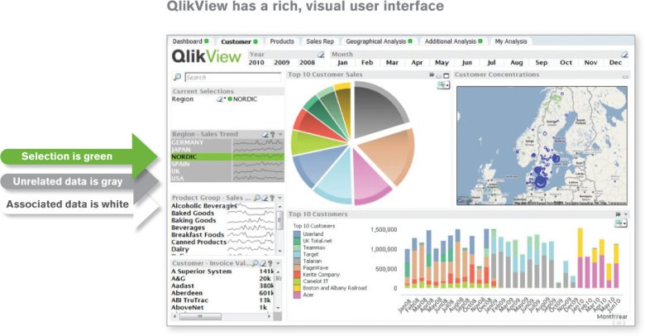
Notes:
This is an example of a QlikView dashboard
You can see that the selected items show up green, the others are grey and associated data is white

Slide 10


Slide 11



New Users
Fisherman: Tracking optimum fishing zones, fleet capacity, most efficient travel routes, etc.
Surgeons: Enabling evidence-based medicine for critically ill children with access to 20 years of data.
Police: Pouring over 10 years of crime reports, equal to 2 billion rows of data, to nab a serial killer on the loose.
Notes:
Better results in the amount of fish caught for fisherman
Surgeons are able to provide better suited medicine and procedures for patients
Police have been able to catch criminals

Slide 12
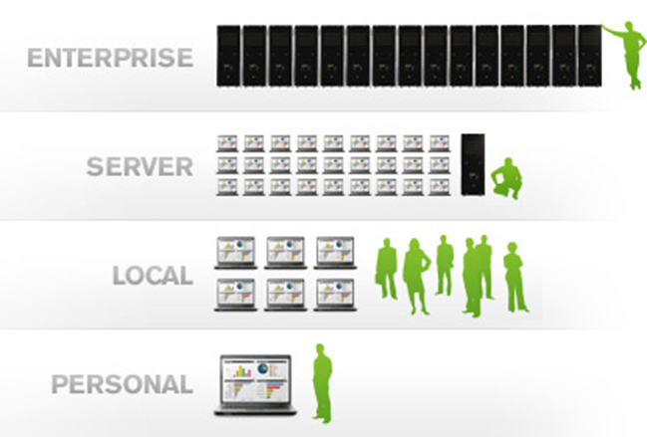
Scalability
Notes:
Live search from any device
Humana

Slide 13

Cloud Capability
Notes:
Customers can access live data anywhere
Data can be stored and pulled down whenever necessary

Slide 14
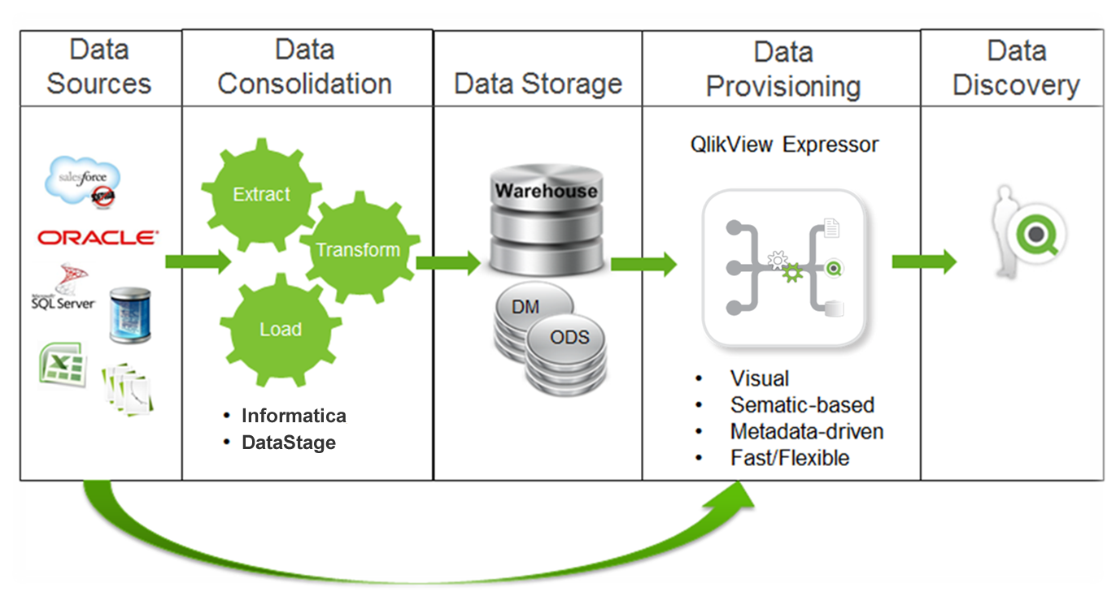
Notes:
Qlikview accepts data from many sources
Makes ETL very easy because it is done in-memory (all done within the QlikView application without help of other technology)
Then pushed out for users to access

Slide 15
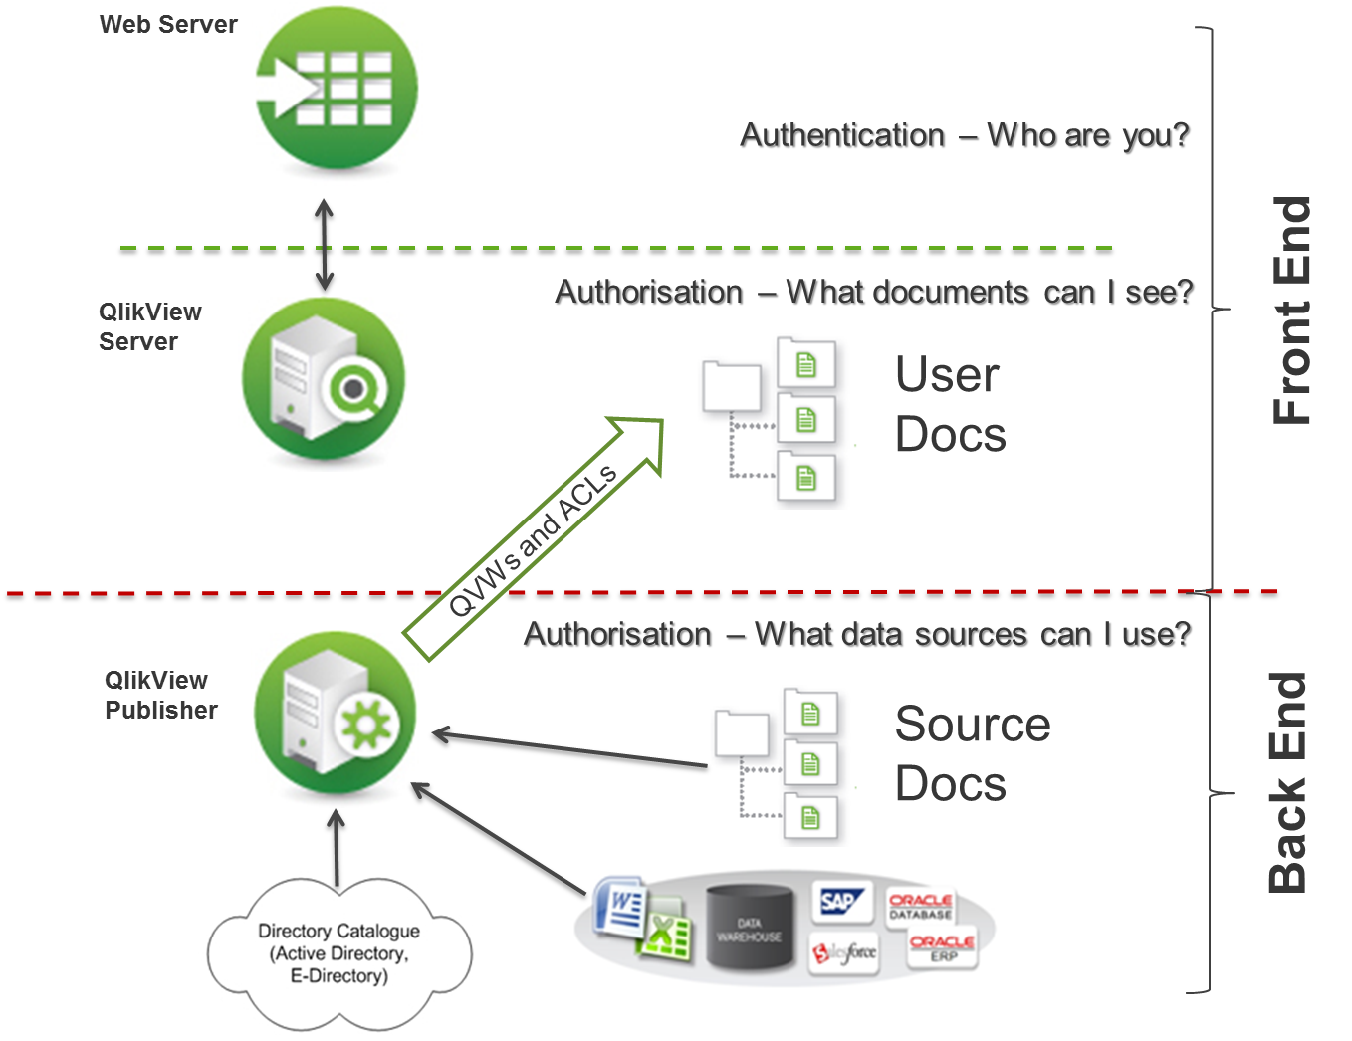
Integration
Notes:
QlikView has the capability of integrating with many other technologies providing for a better user experience
Authorization allows for security in the case of sensitive data

Slide 16
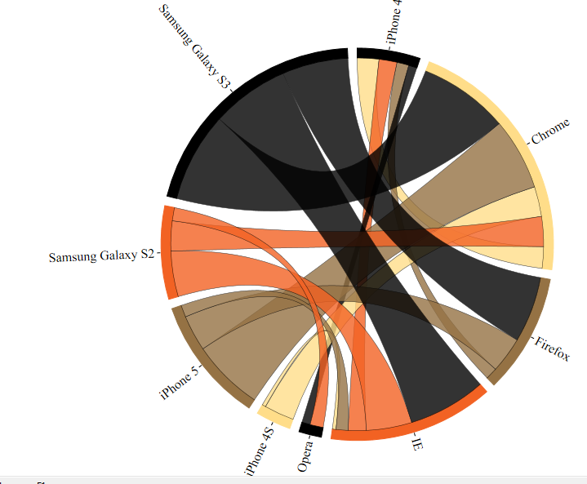
Custom Extensions
Notes:
QlikView allows developers to add on custom extensions such as this
This example shows the relationship between types of phones and web browsers

Slide 17
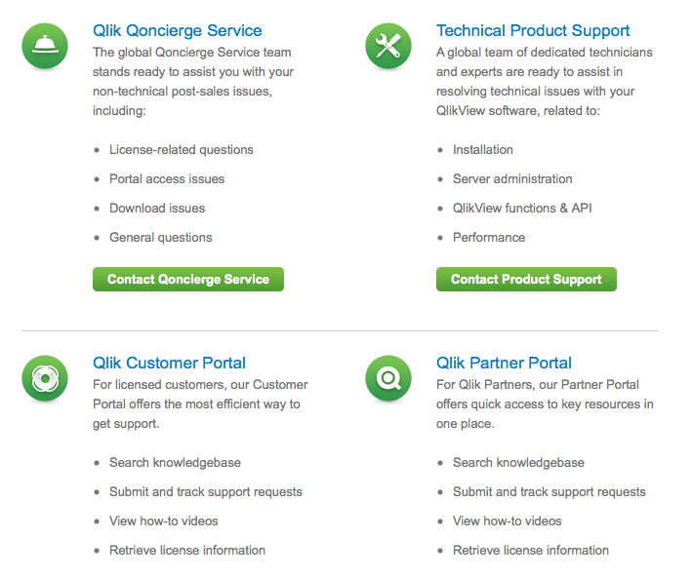
Customer Support
Notes:
They offer 24 hour service to customers
Also QlikCommunity, which allows you to talk to other members using QlikView

Slide 18
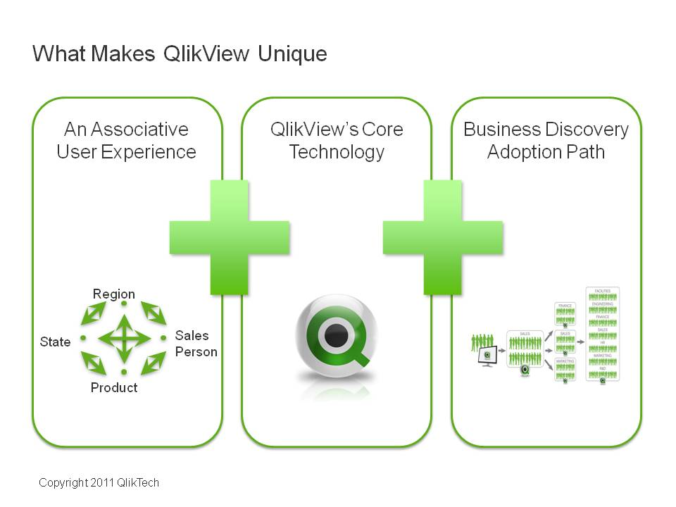
Notes:
All of these features are the reason QlikView has been called the fastest growing BI company in the world
They have differentiated themselves from competitors and made it to the top

Slide 19
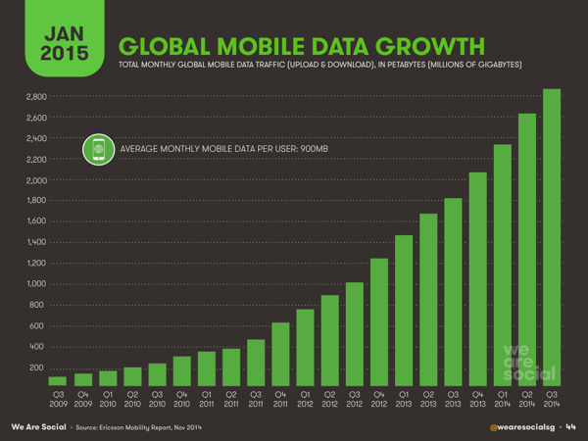
Notes:
Online data usage is increasing at a ridiculous rate
Qlikview allows companies to manage this large amount of data on the fly and across the company

Slide 20
